Slide 1

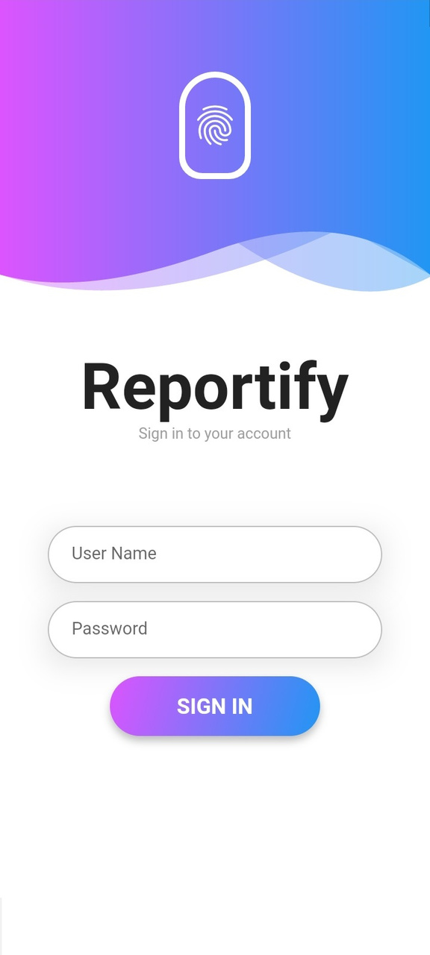
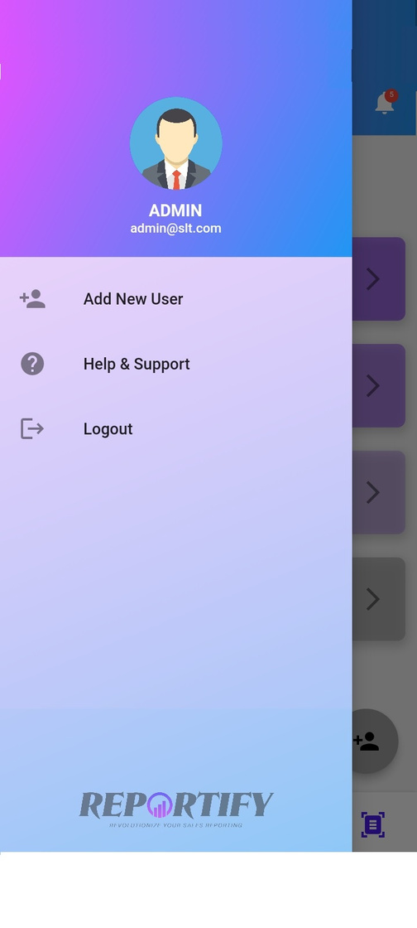
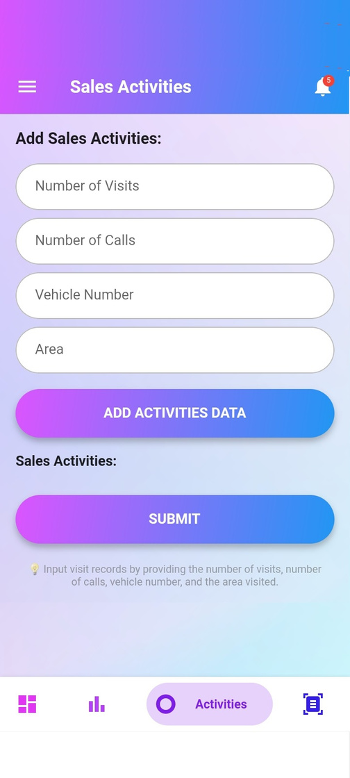
Ravindu Dharmaraja
REPORTIFY
Trainer
Revolutionize Your Sales Reporting
Reportify
How to Use

Slide 2
REPORTIFY
Revolutionize Your Sales Reporting
Content
How to Install
How to Login
Dashboard
Tabs
How to Import Daily Sales
How to Import Daily Sales Activities

Slide 3


REPORTIFY
How to Install
Revolutionize Your Sales Reporting
Reprtify

Slide 4


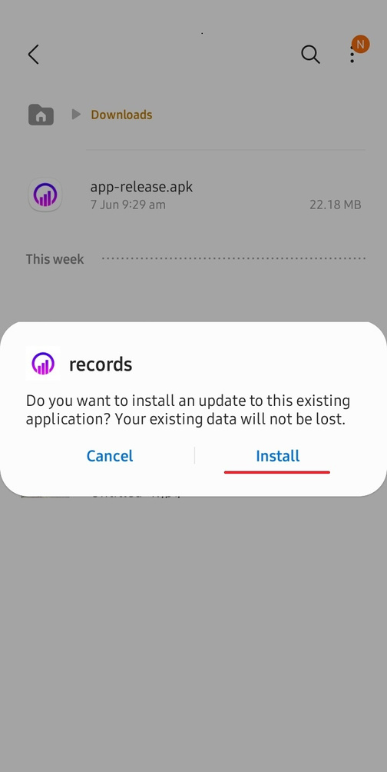
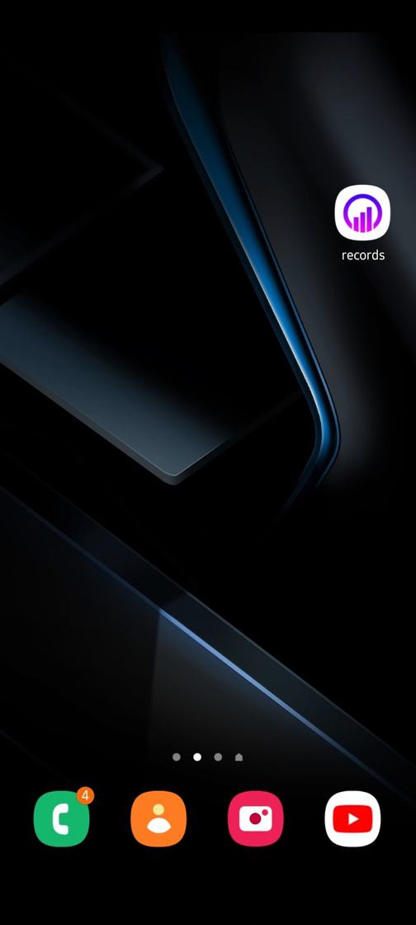
Revolutionize Your Sales Reporting
How to Install

Slide 5

REPORTIFY
How to Login
Revolutionize Your Sales Reporting
'Notch' Product Mockups

Slide 6


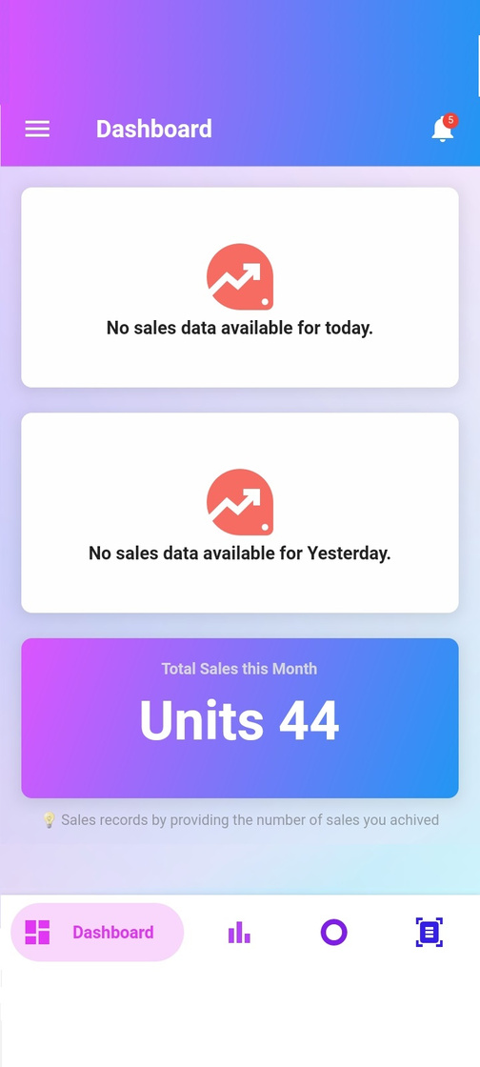
Revolutionize Your Sales Reporting
How to Login

Slide 7
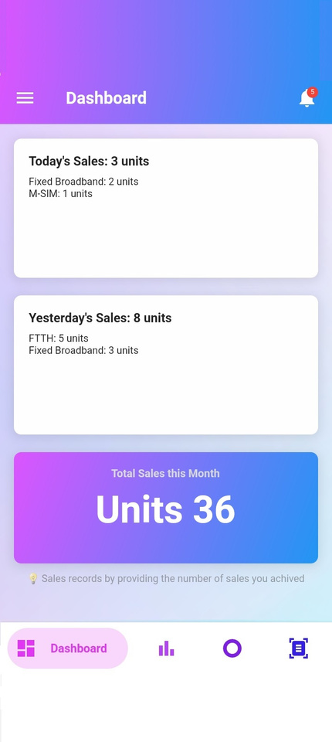
Reportify
Today Sales Performance
Dashboard
Show Today Sales Performance on This Card
Features
Yesterday Sales Performance
Automatic Calculate Total
Easy to Understand
User Friendly Interface
Show Today Sales Performance on This Card
Mounthly Sales Performance
Show Full-Month Total Sales Performance in This.
Revolutionize Your Sales Reporting
Dashboard

Slide 8

REPORTIFY
Tabs
Dashboard
Show All Sales Deatils in This Page
Black is the color of borders, and of authority. Though we have many negative associations with black, we also find it intriguing. Black absorbs all light, so it’s a low-energy color.
Sales Performance
Input Your Daily Sales in This Page
Sales Activities
Input Your Daily Sales Activities Heare
Reports
Genarate Your Sales Report Here
Revolutionize Your Sales Reporting
Tabs

Slide 9

REPORTIFY
How to Import Daily Sales
Revolutionize Your Sales Reporting
Reportify

Slide 10

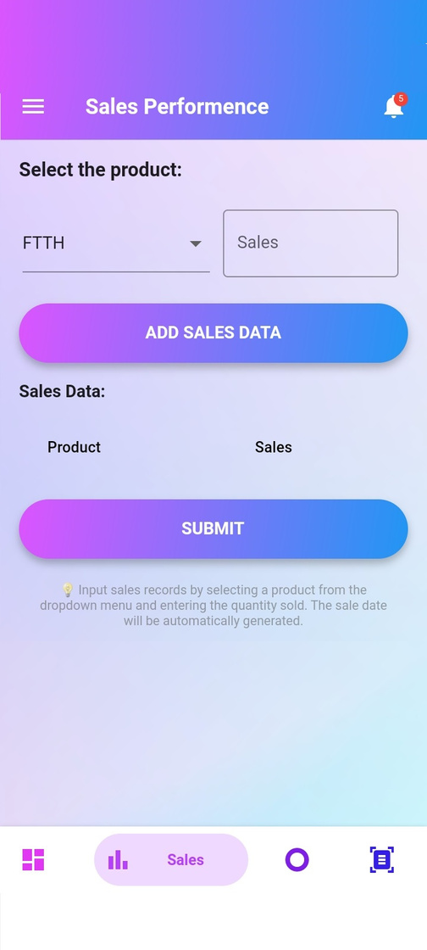
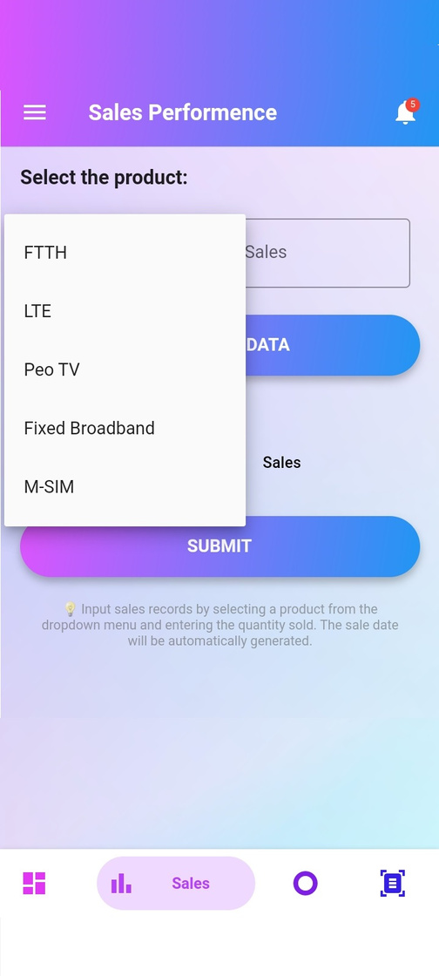
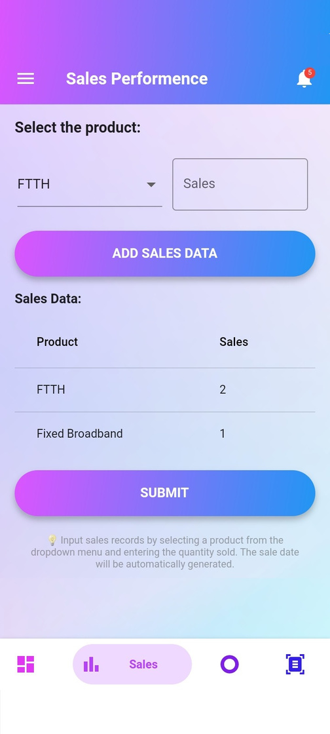
Revolutionize Your Sales Reporting
How to Import Daily Sales

Slide 11

REPORTIFY
How to Import Daily Sales Activities
Revolutionize Your Sales Reporting
Reportify

Slide 12
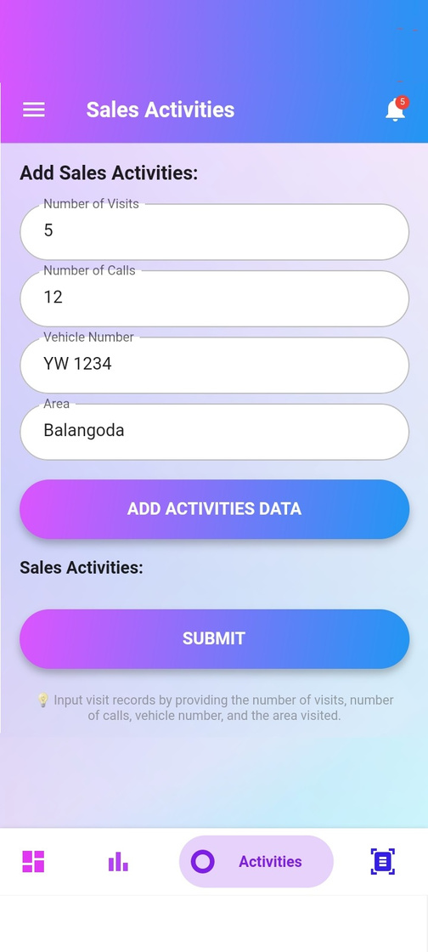
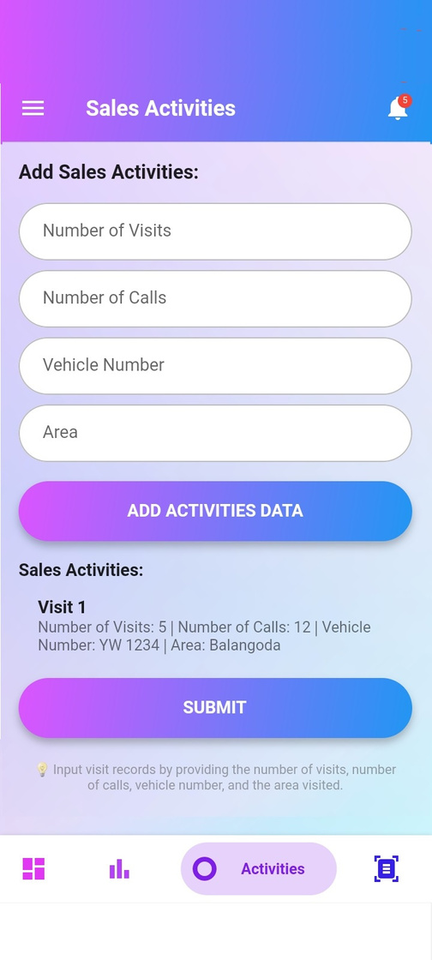
Revolutionize Your Sales Reporting
How to Import Daily Sales Activities

Slide 13
REPORTIFY
Revolutionize Your Sales Reporting
Thank You
ravindudharmaraja00@gmail.com
078 737 9991

